Slide 1




Gender Roles in African Culture
African culture places great importance on gender awareness, recognizing the distinct roles, rights, and expectations of men and women within the community.
by shadrack muthami

Slide 2
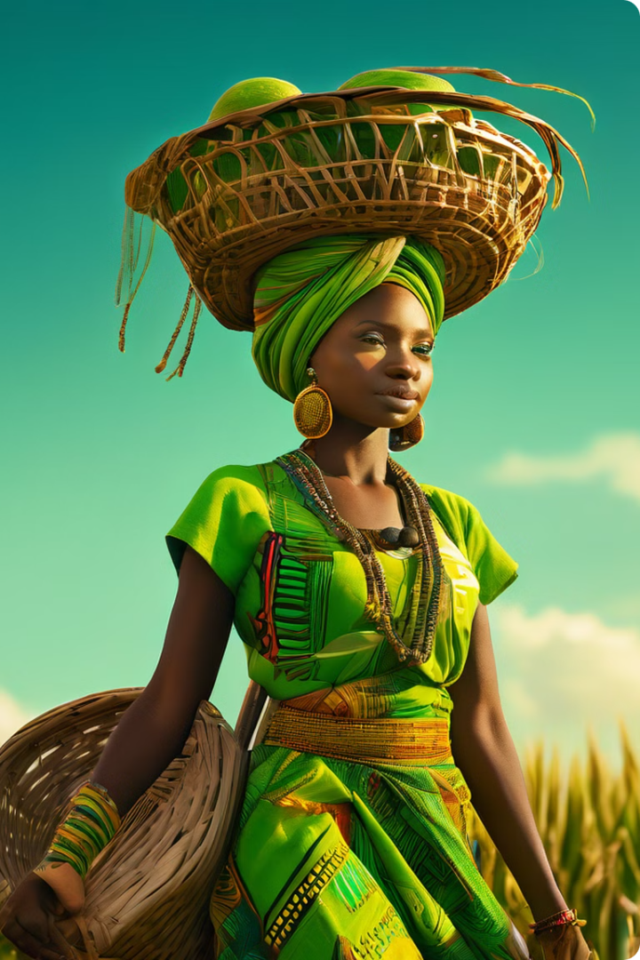
The Role of Women
Household Duties
Women are traditionally responsible for household chores and childcare, supporting the family structure.
Valued Contributions
The labor and contributions of women within the community are recognized and valued.

Slide 3
The Role of Men
Providers
Decision-Makers
Men are often expected to be the primary providers for their families.
Men are typically involved in decision-making processes within the community.

Slide 4

Promoting Equality
1
Challenging Stereotypes
Gender awareness helps challenge stereotypes and promote equality.
2
Empowering Individuals
Recognizing gender roles can empower individuals to reach their full potential.

Slide 5
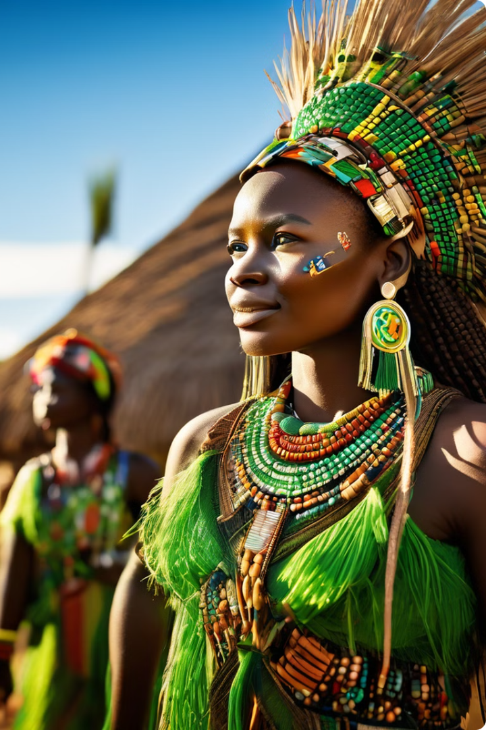
The Zulu Culture
1
Traditional Roles
In Zulu culture, men are often involved in hunting and warfare, while women are responsible for household and childcare duties.
2
Equality and Respect
The Zulu culture emphasizes the importance of gender equality and respect for both men and women.
3
Women in Leadership
Women in the Zulu community hold positions of power and are valued for their wisdom and leadership abilities.

Slide 6



Tradition and Progress
Tradition
Progress
The Zulu culture is rooted in traditional gender roles.
The culture also embraces gender equality and empowerment.

Slide 7




Inclusive Society
Recognizing Strengths
The Zulu culture recognizes the strengths and contributions of both men and women.
Promoting Equity
This promotes a more inclusive and equitable society.
Valuing Perspectives
The Zulu culture values the perspectives and abilities of all its members.

Slide 8
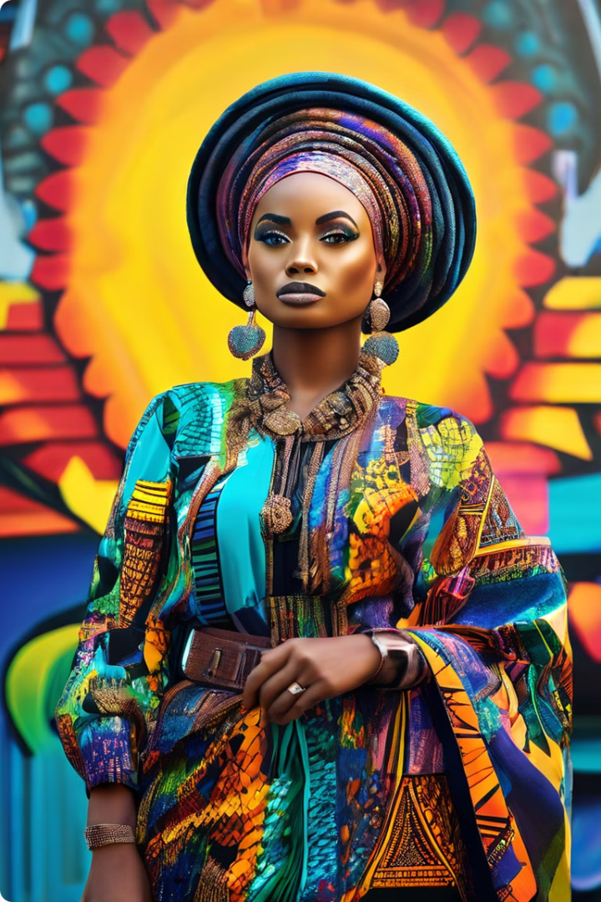
Gender Awareness in African Society
Household Duties
Women are responsible for household chores and childcare.
Decision-Making
Men are typically involved in community decision-making processes.
Equality
Gender awareness promotes equality and challenges stereotypes.
Empowerment
Recognizing gender roles can empower individuals to reach their full potential.

Slide 9
The Zulu Example
Traditional Roles
Equality and Respect
Women in Leadership
In Zulu culture, men are often involved in hunting and warfare, while women are responsible for household and childcare duties.
The Zulu culture emphasizes the importance of gender equality and respect for both men and women.
Women in the Zulu community hold positions of power and are valued for their wisdom and leadership abilities.

Slide 10

Embracing Diversity
Tradition
African cultures are rooted in traditional gender roles.
Progress
These cultures also embrace gender equality and empowerment.
Inclusive Society
By recognizing the strengths and contributions of all, African societies can strive towards a more inclusive and equitable future.

